Slide 1
Hierarchical Transformers for Anomaly Detection in System Log
Guided by
Advisor: Dr Premjith B
Dinesh CB.EN.U4AIE19025
Vaishno P CB.EN.U4AIE19048
Asmitha U CB.EN.U4AIE19065
Logesh. V CB.EN.U4AIE19073

Slide 2
Introduction
Modern computer systems have become increasingly complex as systems grow in both size and functionality. Anomaly detection has become an essential task to build a trustworthy computer system. A single anomaly issue can impact millions of users’ experience and service.
Logs are widely used to record significant events and system status in an operating system or other software systems. Since system logs contain noteworthy events and runtime status, they are one of the most important data sources for anomaly detection and system monitoring.
Log-based anomaly detection methods can be broadly classified into two categories: log event indexes based approaches(e.g. PCA, Invariant Mining, SVM, DeepLog) and log template semantics-based approaches (e.g. LogAnomaly, LogRobust)

Slide 3
Introduction
Log event indexes based approaches first extract log events from log messages and then convert log events into indexes feature spaces. These methods do not attempt to utilize semantic information in log messages. Thus, they cannot handle unseen log templates and suffer from inaccurate log parsing.
Log template semantics based approaches model a log stream as a natural language sequence. They convert log templates into vectors using word vectors and then train their model based on those vectors. Existing approaches are limited to the semantics of log templates but may miss the key values that can be used for anomaly detection.
It is observed that some anomalies are not shown as a deviation from a normal log template sequence but as an abnormal parameter value. Therefore, the values of some specific parameters can be essential factors to be considered in log-based anomaly detection models.

Slide 4
Problem Definition
Log based anomaly detection utilizing transformers to model both log sequence and parameter value.
Challenge:
The proposed model will be tested on the unseen and unstable log sequences.

Slide 5
Literature Review
Title (year) | Authors | Dataset | Methodology | Findings | Improvements done/needed
Hit Anomaly: Hierarchical Transformers for Anomaly Detection in System Log (2020) | Shaohan Huang, Yi Liu, Carol Fung, Rong He, Yining Zhao, Hailong Yang and Zhongzhi Luan | HDFS BGL dataset OpenStack dataset | Hit-Anomaly has three main components: log sequence encoder, parameter values encoder, and attention-based classification. After log sequence encoding and parameter value encoding, HitAnomaly leverages the attention-based structure to classify anomalous logs, which can learn to assign various degrees of importance to log sequences or parameters. | In general, the precision of HitAnomaly is fairly stable with respect to different window sizes or the number of layers. Compared to the original HitAnomaly, HitAnomaly without log sequence encoding has a much lower precision. The information on the log template sequence is essential for the anomaly detection model. | HitAnomaly is a general approach that does not rely on any domain-specific knowledge. One of the future directions is to incorporate the transformer structure into a log-based anomaly prediction task. This, in turn, will be able to predict anomalies before they occur and allows actions to be taken to prevent anomalies from happening and reduce the damage from anomalies.
LAnoBERT: System Log Anomaly Detection based on BERT Masked Language Model (2021) | Yukyung Lee, Jina Kim and Pilsung Kang | HDFS BGL | The operation mechanism of LAnoBERT proposed here because it is executed through MLM, which is a pre-training method of BERT, MLM. First, there is ample data available for training BERT because the log data are collected in real time. Second, MLM does not require the labeling of tasks and accords with the purpose of anomaly detection where only normal data are used for training. Third, MLM is an appropriate methodology to apply to anomaly detection from the perspective of prompt-based learning. | The paper does a comparison study between the performance of LAnoBERT with four selected models - DeepLog, LogRobust, HitAnomaly and LogSy. These results indicate that the log anomaly detection performance is heavily dependent on a parser | The performance of the proposed model should be evaluated through experiments using log data generated from different systems. The training time should be shortened by effectively selecting the log data necessary for training, and a lighter model should be constructed to perform research on real-time anomaly detection. Third, the proposed model constructs a BERT model per dataset to perform anomaly detection.

Slide 6
Title (year) | Authors | Dataset | Methodology | Findings | Improvements done/needed
Machine Learning based Anomaly Detection of Log Files using Ensemble Learning and Self-Attention(2020) | Markus Falt, Stefan Forsstrom, Tingting Zhang∗ | BGL Thunderbird Spirit | Nedelkoski, Bogatinovski, Acker, et al. presents a method called Logsy, for anomaly detection of log data. Logsy uses additional log data sources to supplement the negative training samples,. This article tries to see if generalized models trained on only additional log data sources can be successfully applied to unseen log data sources. | The work was compared to Logsy because it uses a similar method and was the inspiration for this work. MWT Log does not use data from the target system for training, and instead relies completely on labeled log data from auxiliary systems. MWT Log is also likely to be much slower with both training and predicting. The reason MWT Log is much slower is because of the ensemble learning technique that is used | The performance of the method was only tested on three labeled data sets, more testing is however required to better judge the method’s performance
TRANSLOG: A Unified Transformer-based Framework for Log Anomaly Detection(2021) | Hongcheng Guo1∗, Xingyu Lin4, Jian Yang1, Yi Zhuang2 | HDFS BGL Thunderbird | Our model is first pretrained on the source domain to obtain shared semantic knowledge of log data. Then, we transfer the pretrained model to the target domain via adapter-based tuning. The proposed method is evaluated on three public datasets including one source domain and two target domains | we conduct the ablation study in four aspects for a penetrating analysis of TRANSLOG, including the effect of the pretrained model, the gap between pretrained log models, the efficiency of adapter-based tuning, and the low resource study. | In this paper, we propose TRANSLOG, a unified transformer based framework for log anomaly detection, which contains the pretraining stage and the adapter-based tuning stage. Extensive experiments demonstrate that our TRANSLOG, with fewer trainable parameters and lower training costs, outperforms all previous baselines. We foresee the semantic migration between log sources for a unified multiple sources detection.
Anomaly Adapters: Parameter-Efficient Multi-Anomaly Task Detection (2021) | UĞUR ÜNAL AND HASAN DAĞ , (Member, IEEE) | Hadoop Distributed File Systems (HDFS), The firewall dataset | Anomaly Adapters (AAs) which is an extensible multi-anomaly task detection model. It uses pretrained transformers’ variant to encode a log sequences and utilizes adapters to learn a log structure and anomaly types is proposed in this paper. Considering each log as a sentence and system-calls as a language; aim is to gain semantic information through adapters to distinguish anomalies. | This paper compared this work with other recent studies in the field and also tested model decisions to get feedback in a readable form. | To focus on collaborating with algorithms in learning which interprets semantic-based anomaly detection models. By this way, create intelligible decisions may be created, which can be acted efficiently and timely.

Slide 7
Title (year) | Authors | Dataset | Methodology | Findings | Improvements done/needed
TranAD: Deep Transformer Networks for Anomaly Detection in Multivariate Time Series Data (2022) | Shreshth Tuli, Giuliano Casale, Nicholas R. Jennings Loughborough | Numenta Anomaly Benchmark (NAB),Mars Science Laboratory (MSL) dataset, Multi-Source Distributed System (MSDS) Dataset | TranAD, a deep transformer network based anomaly detection and diagnosis model which uses attention based sequence encoders is proposed in this paper. It uses focus score-based self-conditioning to enable robust multi-modal feature extraction and adversarial training to gain stability. | The transformer based encoder-decoder allows quick model training and high detection performance for a variety of datasets considered in this work. TranAD leverages self-conditioning and adversarial training to amplify errors and gain training stability. Moreover, meta-learning allows it to be able to identify data trends even with limited data. | The method with other transformer models like bidirectional neural networks to allow model generalization to diverse temporal trends in data. To explore the direction of applying cost-benefit analysis for each model component based on the deployment setting to avoid expensive computation.
IT Infrastructure Anomaly Detection and Failure Handling: A Systematic Literature Review Focusing on Datasets, Log Preprocessing, Machine and Deep learning approaches and Automated tool (2021) | Deepali Arun Bhanage, Ambika Vishal Pawar and Ketan Kotecha | HDFS BGL HPC Linux system log Android framework log Apache Server error log Proxifier software log | The failure prediction pipeline in IT infrastructure to avoid failure conditions is divided into 4 parts: Raw log data preprocessing and feature extraction in which a drain parser is used for semantic analysis. After training, a balanced testing dataset will be provided and an alert is generated to notify the system admin if there is a prediction of potential failures in the system. | The paper is systematic literature review (SLR) of previous research works. The results were more accurate i.e., above 90% for most of the log data of different IT infrastructures. | Quality data can be collected to improve the prediction accuracy and also to identify the pattern of failures to help minimize the data usage. User Interface (UI)-based monitoring consoles and automated systems can be built to monitor the components in IT infrastructure better.
Sequential Anomaly Detection for Log Data Using Deep Learning (2021) | Lina Hammargren, Wei Wu | HDFS Volvo Group Trucks Technology (Volvo GTT) | The raw log data is filtered out using regex to remove patterns of numerical values, non-alphanumeric characters and empty lines. Then it is converted into integer sequence using sliding window technique to resolve the issue of long-term dependencies with sequence modelling and to decrease the length of the sequences to perform pattern recognition on. This sequence is one-hot encoded and given to the model. A total of four neural network model architectures are applied; unidirectional LSTM, bi-directional LSTM, LSTM sequence-to-sequence & sequence-to-sequence transformer model. | Out of the anomaly detection approaches investigated in this project, the uni-LSTM model and the transformer model trained on 1% of the Volvo GTT data and 100% of the normal HDFS data perform best. The bi-LSTM model performs worse than the uni-LSTM model. As the anomalies exist at the bottom of the log file, then the bi-LSTM model has no chance to indicate them as it reads from both ends. | The preprocessing method can be replaced by log parsers such as Spell and Drain. Adding an attention mechanism to the LSTM sequence model would improve the model. Other problem definition approaches to the sequence-to-sequence models could be considered, such as taking content of the log lines into consideration.

Slide 8
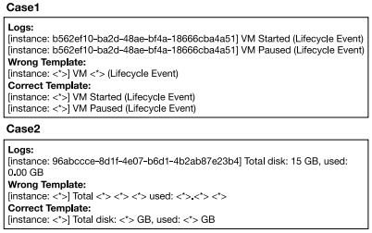
Open Questions / Gaps in the Literature
Inaccurate log parsing may cause false alarms, which is not avoidable even when Drain parser is used. If only log templates are used to detect anomalies, the model cannot identify the status of the system as shown in the figure. This parsing error may cause some potentially relevant information to be lost, which is not conducive to anomaly detection.
Log event indexes based methods transform log templates from log sequences into log template indexes. They employ machine learning models to detect anomalies. The limitation of these methods is that template indexes ignore the context information and cannot provide any semantic information.
Log template semantics based approaches utilize word embedding to transform log templates into vectors. Compared to the latter, these methods are able to capture the semantic information in log templates and deal with new log templates, to some degree. However, they only utilize log template sequences and ignore the semantic information of parameter values.

Slide 9
Objectives
To develop a transformer structure to model and capture the semantic information on both log template sequences and parameter values.
To design an attention mechanism to merge the semantic information log sequences and parameter values to detect log anomalies.

Slide 10
DATA SET DESCRIPTION
Dataset is collected from Github user @Zhujiem for his project A large collection of system log datasets for log analysis research.
Dataset used in this project is HDFS, BGL and Openstack.
DATASETS | DURATION | # OF LOGS | SIZE
HDFS | 38.7 hours | 11,175,629 | 1.47 GB
BGL | 214.7 days | 4,747,963 | 708.76 MB
Openstack | - | 70,746 | 58.61 MB

Slide 11
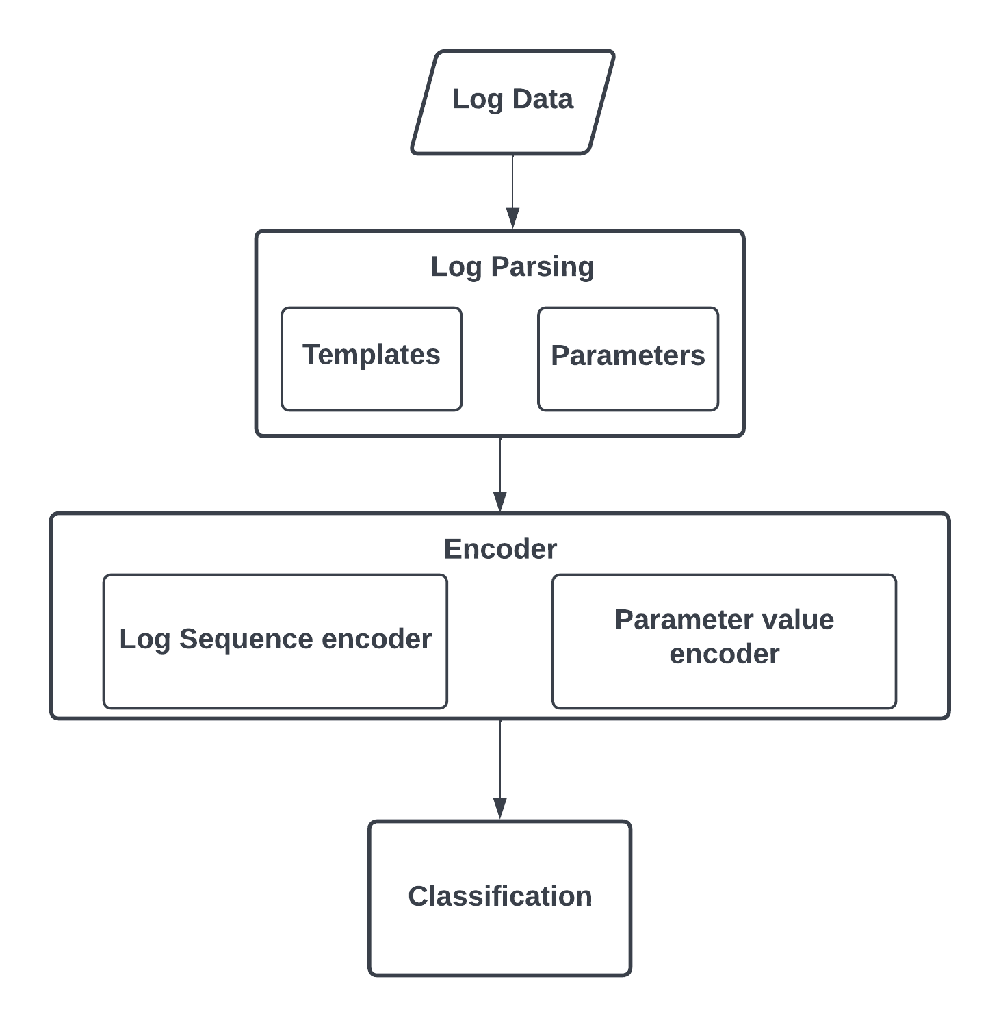

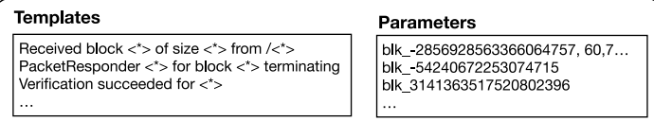
METHODOLOGY
DeepLog proposed a parameter value detection model, which views each parameter value vector sequence as a separate time series. It utilizes a transformer network to capture the semantic information in parameter values.
Single log encoder to transform each log event into a vector using transformer blocks and log sequence encoder to leverage a transformer structure in order to learn a sequence of logtemplates representations.
Considering log sequence representation and parameter sequence representation Attention based classification is devised.

Slide 12
Tentative Timeline
15-08-2022 –
30-08-2022
16-09-2022 –
30-09-2022
16-10-2022 –
30-10-2022
Designing the problem statement
Pre-Processing & Encoding
Training the Model
Improvements Based on results
Final Result
01-09-2022 –
15-09-2022
01-10-2022 –
15-10-2022

Slide 13
REFERENCES
Tuli, Shreshth, Giuliano Casale, and Nicholas R. Jennings. "TranAD: Deep transformer networks for anomaly detection in multivariate time series data." arXiv preprint arXiv:2201.07284 (2022).
Huang, Shaohan, et al. "Hitanomaly: Hierarchical transformers for anomaly detection in system log." IEEE transactions on network and service management 17.4 (2020): 2064-2076.
U. Ünal and H. Dağ, "AnomalyAdapters: Parameter-Efficient Multi-Anomaly Task Detection," in IEEE Access, vol. 10, pp. 5635-5646, 2022, doi: 10.1109/ACCESS.2022.3141161.
D. A. Bhanage, A. V. Pawar and K. Kotecha, "IT Infrastructure Anomaly Detection and Failure Handling: A Systematic Literature Review Focusing on Datasets, Log Preprocessing, Machine & Deep Learning Approaches and Automated Tool," in IEEE Access, vol. 9, pp. 156392-156421, 2021, doi: 10.1109/ACCESS.2021.3128283.

Slide 14
REFERENCES
M. Fält, S. Forsström and T. Zhang, "Machine Learning Based Anomaly Detection of Log Files Using Ensemble Learning and Self-Attention," 2021 5th International Conference on System Reliability and Safety (ICSRS), 2021, pp. 209-215, doi: 10.1109/ICSRS53853.2021.9660694.
Hammargren, Lina, and Wei Wu. "Sequential Anomaly Detection for Log Data Using Deep Learning." (2021).
Lee, Yukyung, Jina Kim, and Pilsung Kang. "LAnoBERT: System Log Anomaly Detection based on BERT Masked Language Model." arXiv preprint arXiv:2111.09564 (2021).
Guo, Hongcheng, et al. "TransLog: A Unified Transformer-based Framework for Log Anomaly Detection." arXiv preprint arXiv:2201.00016 (2021).

